Slide 1
Consumer Price Index (CPI) time series modeling
Winters Additive vs ARIMA(1,0,3)(0,1,1)
Assessment 3
Time Series & M-V Analysis - STAT8008
Higher Diploma in Data Science and Analytics
30.04.2018 / João Viegas / R00157699

Slide 2
Overview
Dataset
Models
Winters Additive
Arima(1,0,3)(0,1,1)
Selection
Estimation and Forecasting - splitted data (training dataset)
True Forecast
Conclusions

Slide 3
Dataset

Slide 4
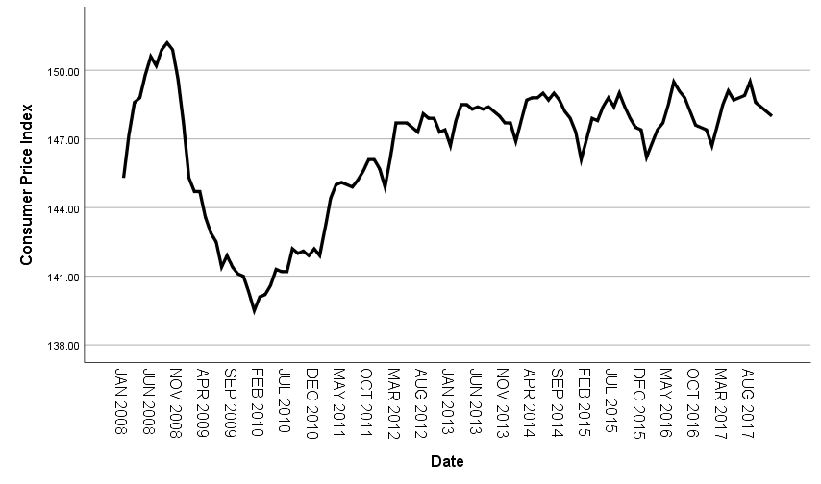
Dataset
Consumer Price Index (CPI)
Ireland
January 2008 to December 2017
seasonal;
cycles difficult to predict;
2 phases:
runup & dip;
recovery to lower growth;

Slide 5
Models

Slide 6
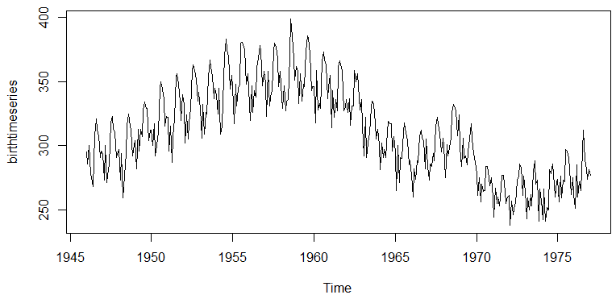
Models: Winters Additive
Increasing / decreasing series
seasonal pattern of constant magnitude

Slide 7
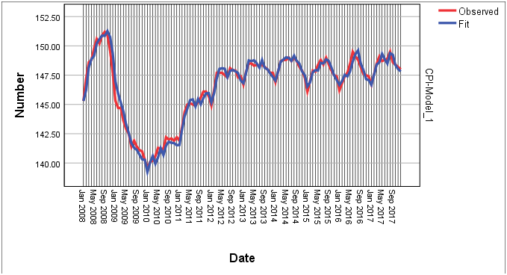
Models: Winters Additive
Model |  |  | Estimate | SE | t | Sig.
Consumer Price Index-Model_1 | No Transformation | Alpha (Level) | 1 | 0.091 | 10.95 | 0
 |  | Gamma (Trend) | 0.102 | 0.029 | 3.525 | 0.001
 |  | Delta (Season) | 0.999 | 9361.466 | 0 | 1
Smoothed components:
level: S(t) = S(t−1) + T(t−1) + 𝜶𝜺(t) trend: T(t) = T(t−1) + 𝜶𝜸𝜺(t) seasonal: I(t) = I(t−p) + 𝜹(1 − 𝜶)𝜺(t)
Predicted:
y(t+m) = S(t) + mT(t) + I(t−p+m)
Note: 𝜹 nonsignificant

Slide 8
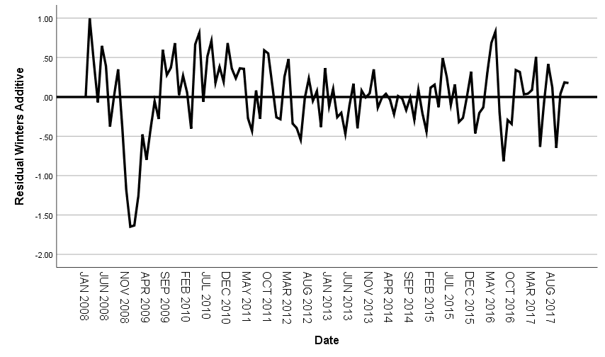
Models: Winters Additive
Number of Predictors |  | 0
Model Fit statistics | Stationary R-squared | 0.659
 | R-squared | 0.974
 | RMSE | 0.454
 | MAPE | 0.227
 | MAE | 0.332
 | MaxAPE | 1.124
 | MaxAE | 1.649
 | Normalized BIC | -1.461
Ljung-Box Q(18) | Statistics | 65.146
 | DF | 15
 | Sig. | 0
Number of Outliers |  | 0
fit measures
Stationary R-Squared: substantial explanation;
Low error values;
Ljung-Box statistic not significant (no autocorrelation);
residuals sequence plot

Slide 9
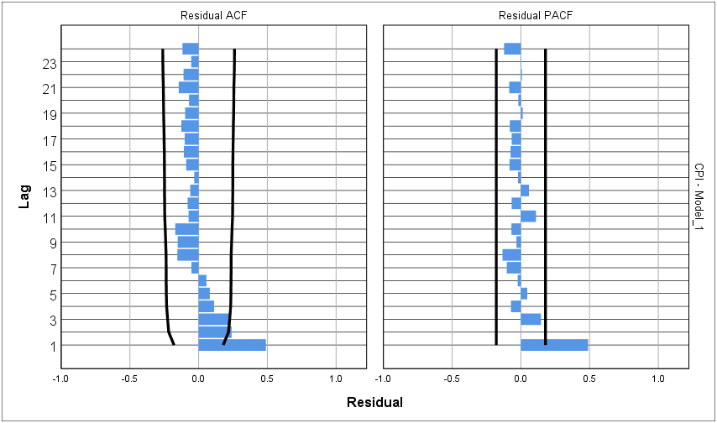
Models: Winters Additive
Residuals autocorrelation
first lag maybe autocorrelated;
probably effect of initial phase
not confirmed by Ljung-Box statistic
short time series

Slide 10
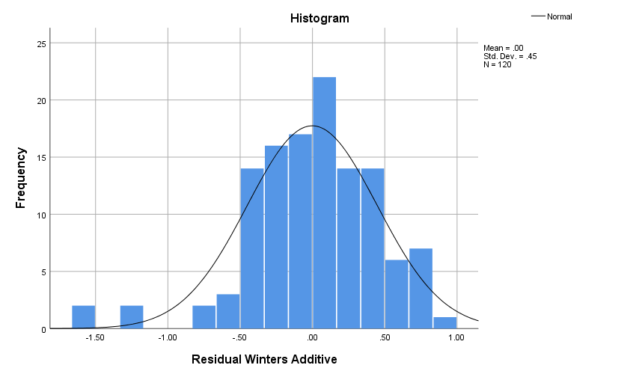
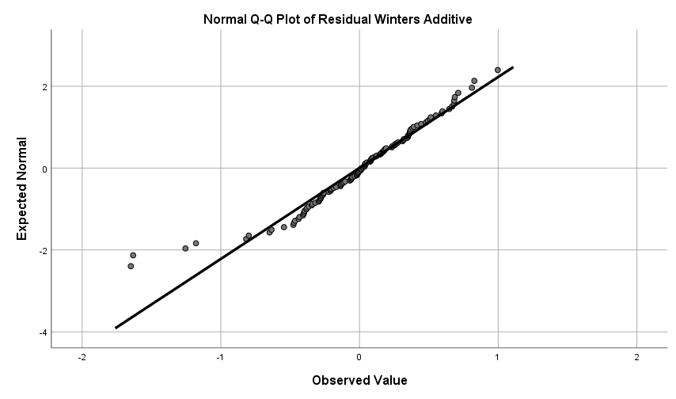
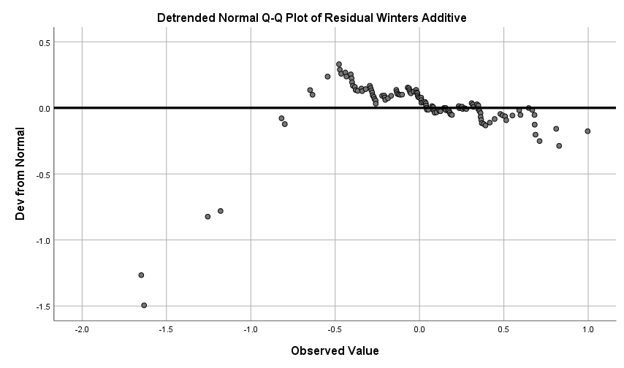
Models: Winters Additive
 | Kolmogorov-Smirnovª |  |  | Shapiro-Wilk
 | Statistic | df | Sig. | Statistic | df | Sig.
Residual Winters Additive | 0.07 | 120 | .200* | 0.951 | 120 | 0
ª Lilliefors Significance Correction
Residuals normality assumption
Kolmogorov: yes
Shapiro: no
Histogram: maybe yes
Normal Q-Q plot: maybe yes
Detrended Normal Q-Q plot: maybe not

Slide 11
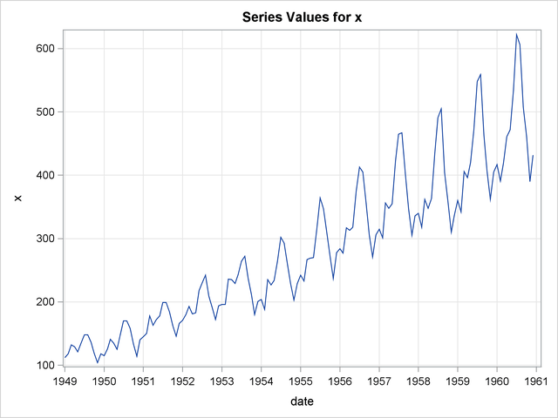
Models: Arima(1,0,3)(0,1,1)
ARIMA(p,d,q)(P,D,Q)
p/P: autoregressive process order
d/D: differencing order (to become stationary)
q/Q: moving average process order
𝑌_{𝑡} = 𝑓₁𝑌_{𝑡−1} + 𝑓₂𝑌_{𝑡−2} + ⋯ + 𝑓_{𝑝}𝑌_{𝑡−𝑝} + 𝜖_{𝑡} − 𝑏₁𝜖_{𝑡−1} − 𝑏₂𝜖_{𝑡−2} − ⋯ − 𝑏_{𝑞}𝜖_{𝑡−q}

Slide 12
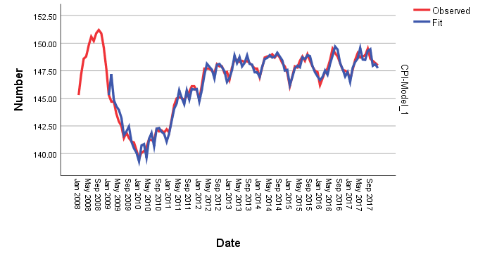
Models: Arima(1,0,3)(0,1,1)
ARIMA (1,0,3)(0,1,1) Model Parameters |  |  |  | Estimate | SE | t | Sig.
Consumer Price Index | No Transformation | AR | Lag 1 | 0.964 | 0.037 | 25.869 | 0
 |  | MA | Lag 1 | -0.591 | 0.093 | -6.322 | 0
 |  |  | Lag 2 | -0.248 | 0.112 | -2.216 | 0.029
 |  |  | Lag 3 | -0.272 | 0.103 | -2.635 | 0.01
 |  | Seasonal Difference |  | 1
 |  | MA, Seasonal | Lag 1 | 0.89 | 0.224 | 3.973 | 0
all the parameters, non-seasonal and seasonal are significant;
fit values follow the observed ones closely;

Slide 13
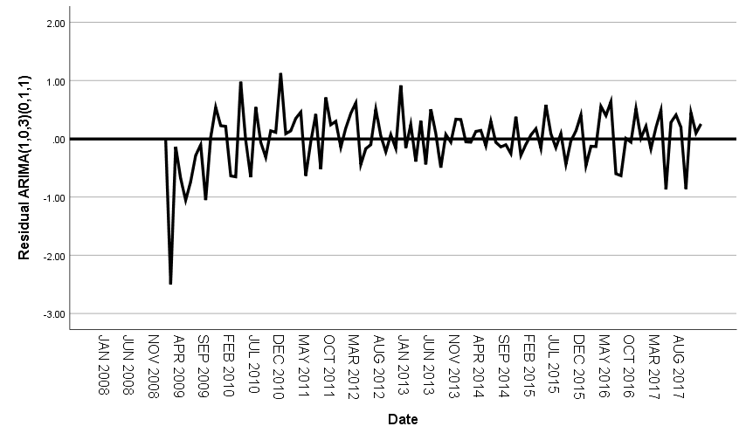
Models: Arima(1,0,3)(0,1,1)
Number of Predictors |  | 0
Model Fit statistics | Stationary R-squared | 0.975
 | R-squared | 0.969
 | RMSE | 0.492
 | MAPE | 0.237
 | MAE | 0.345
 | MaxAPE | 1.728
 | MaxAE | 2.5
 | Normalized BIC | -1.202
Ljung-Box Q(18) | Statistics | 12.342
 | DF | 13
 | Sig. | 0.5
Number of Outliers |  | 0
fit measures
Stationary R-Squared: substantial explanation;
Low error values;
Normalized BIC > Winters => not as good
Ljung-Box statistic on significance limit;
residuals sequence plot

Slide 14
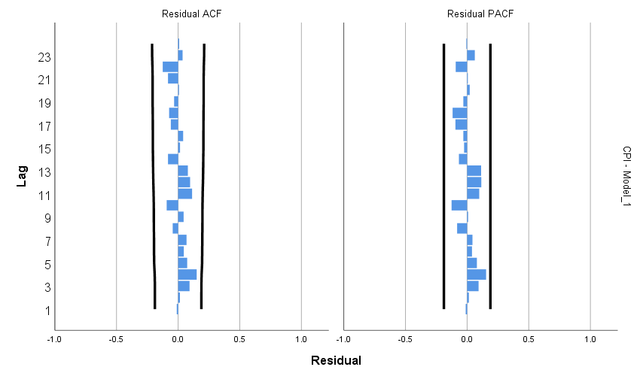
Models: Arima(1,0,3)(0,1,1)
Residuals autocorrelation
No autocorrelation in any lag

Slide 15
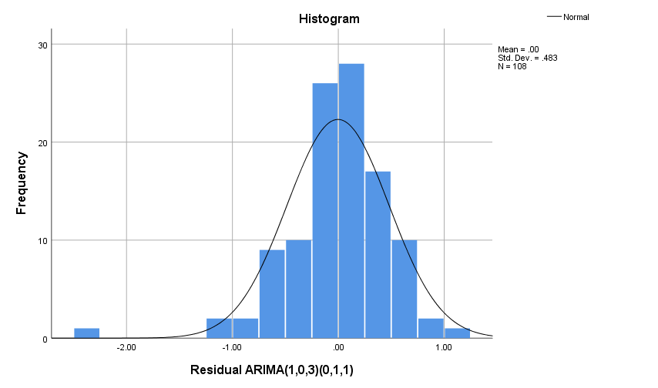
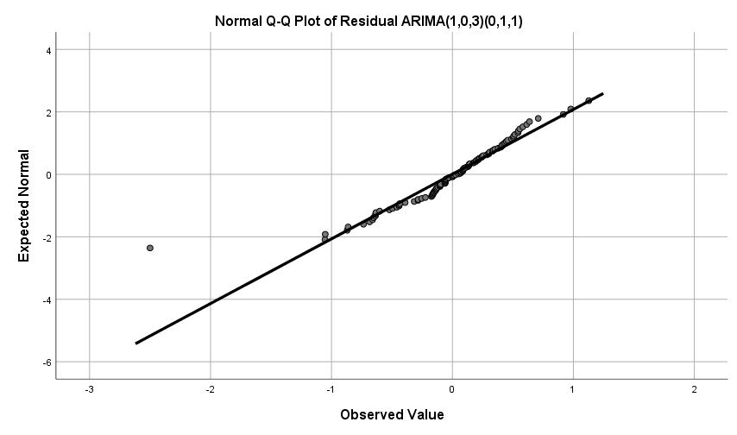
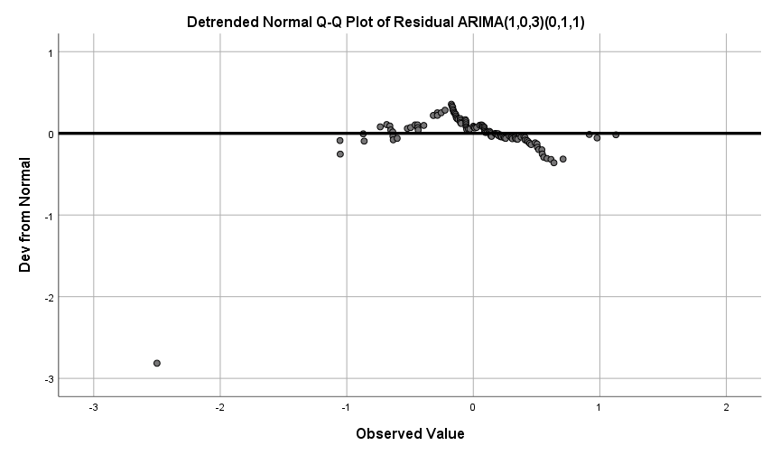
Models: Arima(1,0,3)(0,1,1)
 | Kolmogorov-Smirnovª |  |  | Shapiro-Wilk
 | Statistic | df | Sig. | Statistic | df | Sig.
Residual ARIMA(1,0,3)(0,1,1) | 0.13 | 108 | 0 | 0.921 | 108 | 0
ª Lilliefors Significance Correction
Residuals normality assumption
Kolmogorov: no
Shapiro: no
Histogram: maybe yes
Normal Q-Q plot: maybe yes
Detrended Normal Q-Q plot: maybe no

Slide 16
Models: Selection
 | Winters Additive | ARIMA(1,0,3)(0,1,1)
model parameters | Delta parameter, season related, is nonsignificant | all parameters significant
observed vs Fit values | good | good
residuals | less accurate in the beginning with not that mush randomness, variance increases in the last phase | less accurate in the beginning with not that mush randomness, variance increases in the last phase
fit and measure statistics | Similar errors (RMSE,MAE,etc) | Similar errors (RMSE,MAE,etc)
 | Better BIC (lower)
 | R-square stationary=0.659 | better R-square stationary(for non stationary data) =0.975
 | Ljung-Box non significant | Ljung-Box on the limit of significance
ACF and PACF | some autocorrelation in the 1st phase | no autocorrelation
normality of residuals | assuming normal | assuming normal

Slide 17
Estimation and Forecasting
splitted data (training dataset)

Slide 18
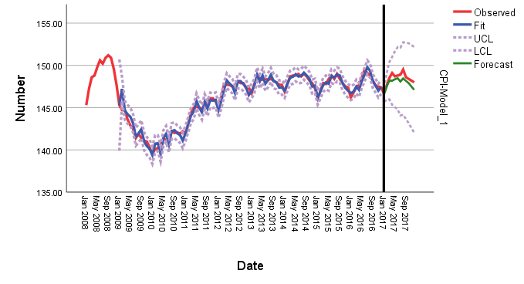
Estimation and Forecasting
 |  |  |  | Estimate | SE | t | Sig.
Consumer Price Index | No Transformation | AR | Lag 1 | 0.964 | 0.043 | 22.158 | 0
 |  | MA | Lag 1 | -0.679 | 0.096 | -7.087 | 0
 |  |  | Lag 2 | -0.338 | 0.119 | -2.846 | 0.005
 |  |  | Lag 3 | -0.338 | 0.106 | -3.197 | 0.002
 |  | Seasonal Difference |  | 1
 |  | MA, Seasonal | Lag 1 | 0.948 | 0.612 | 1.548 | 0.125
Estimation: Jan 2008 to Dec 2016;
Training: Jan 2017 to Dec 2017;
Seasonal MA parameter not significant;
fit values follow the observed ones closely;

Slide 19
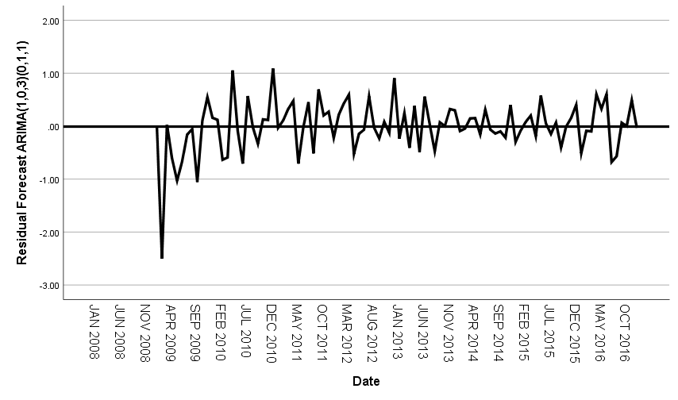
Estimation and Forecasting
Number of Predictors |  | 0 | Selection Phase
Model Fit statistics | Stationary R-squared | 0.977 | 0.975
 | R-squared | 0.97 | 0.969
 | RMSE | 0.498 | 0.492
 | MAPE | 0.232 | 0.237
 | MAE | 0.338 | 0.345
 | MaxAPE | 1.728 | 1.728
 | MaxAE | 2.5 | 2.5
 | Normalized BIC | -1.156 | -1.202
Ljung-Box Q(18) | Statistics | 14.144 | 12.342
 | DF | 13 | 13
 | Sig. | 0.364 | 0.5
Number of Outliers |  | 0 | 0
fit measures
generally slightly better;
Low error values;
Normalized BIC > Selection phase => not as good
Ljung-Box statistic not significant;
residuals sequence plot

Slide 20
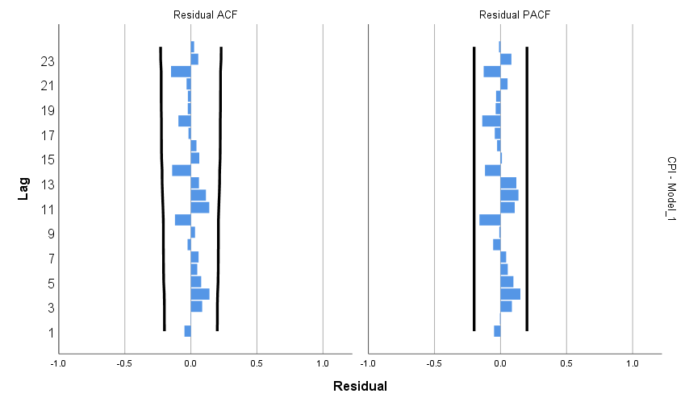
Estimation and Forecasting
Residuals autocorrelation
No autocorrelation in any lag

Slide 21
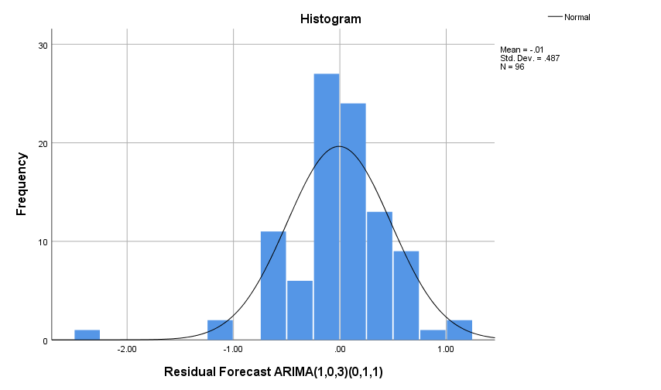
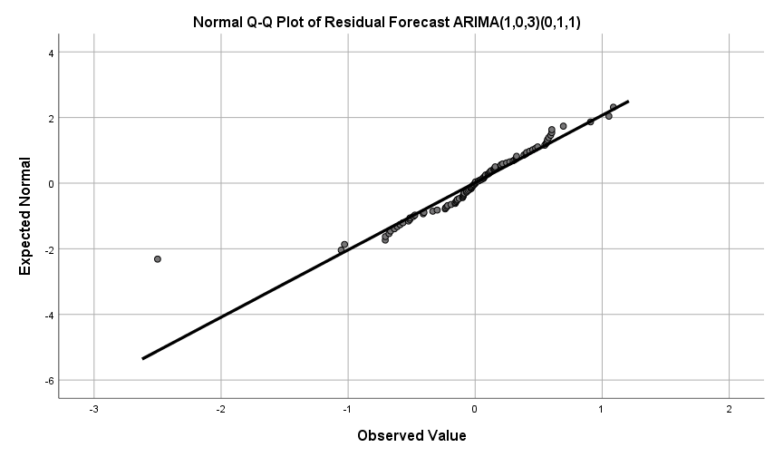
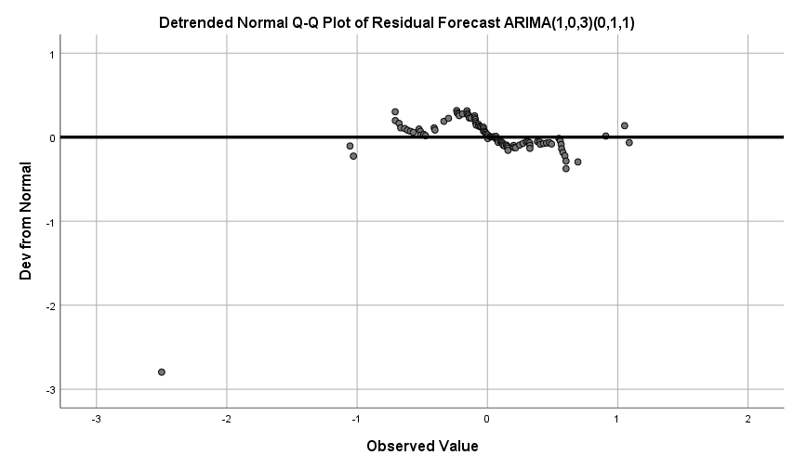
Estimation and Forecasting
 | Kolmogorov-Smirnovª |  |  | Shapiro-Wilk
 | Statistic | df | Sig. | Statistic | df | Sig.
Residual Forecast ARIMA(1,0,3)(0,1,1) | 0.12 | 96 | 0.002 | 0.913 | 96 | 0
ª Lilliefors Significance Correction
Residuals normality assumption
Kolmogorov: no
Shapiro: no
Histogram: maybe yes
Normal Q-Q plot: maybe yes
Detrended Normal Q-Q plot: maybe yes

Slide 22
True Forecast

Slide 23
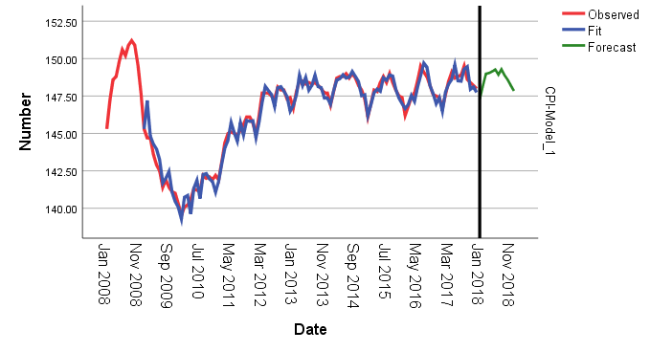
True Forecast
Estimation: Jan 2008 to Dec 2017;
Forecasting: Jan 2018 to Dec 2018;
Model parameters are the same as in Selection phase;
replicates the seasonality and slight upbeat trend seen in the latest stages of the observed data;

Slide 24
Conclusions
models struggle with 1st phase;
Cyclical component hard to predict;
models adapt reasonably well to inflections;
Don’t predict too much into the future;
Incorporate errors asap;

Slide 25

thank you
obrigado

